Slide 1


THREATIFY- Threat Detection using CCTV
Mid Evaluation
Group Members: Muhammad Abdullah i170038 Haasha Bin Atif i170183 Muhammad Ahmed i170184
Supervisor: Dr. Omer Ishaq

Slide 2
Content
Introduction
Poster
Timeline
Progress
Results
User Interface (UI)
Reference
Q&A

Slide 3
Introduction
Problem statement: - We observe criminal activities daily in our lives. Many times, the criminal can escape just because the reporting time was slow. To improve the reporting time of a crime, we are making a deep learning model that can identify and classify criminal activities as threats and report this to the associated organization as soon as possible.
Project scope: - Our scope includes collecting a dataset of videos on criminal activities. Then developing a deep learning model. We then devise a system which automatically sends a threat notification to the user and to the associated organization once the threat is detected. At the very end, we have to develop an application for user, which can be used by the user end for viewing threats observed in the video feed provided by their CCTV.

Slide 4
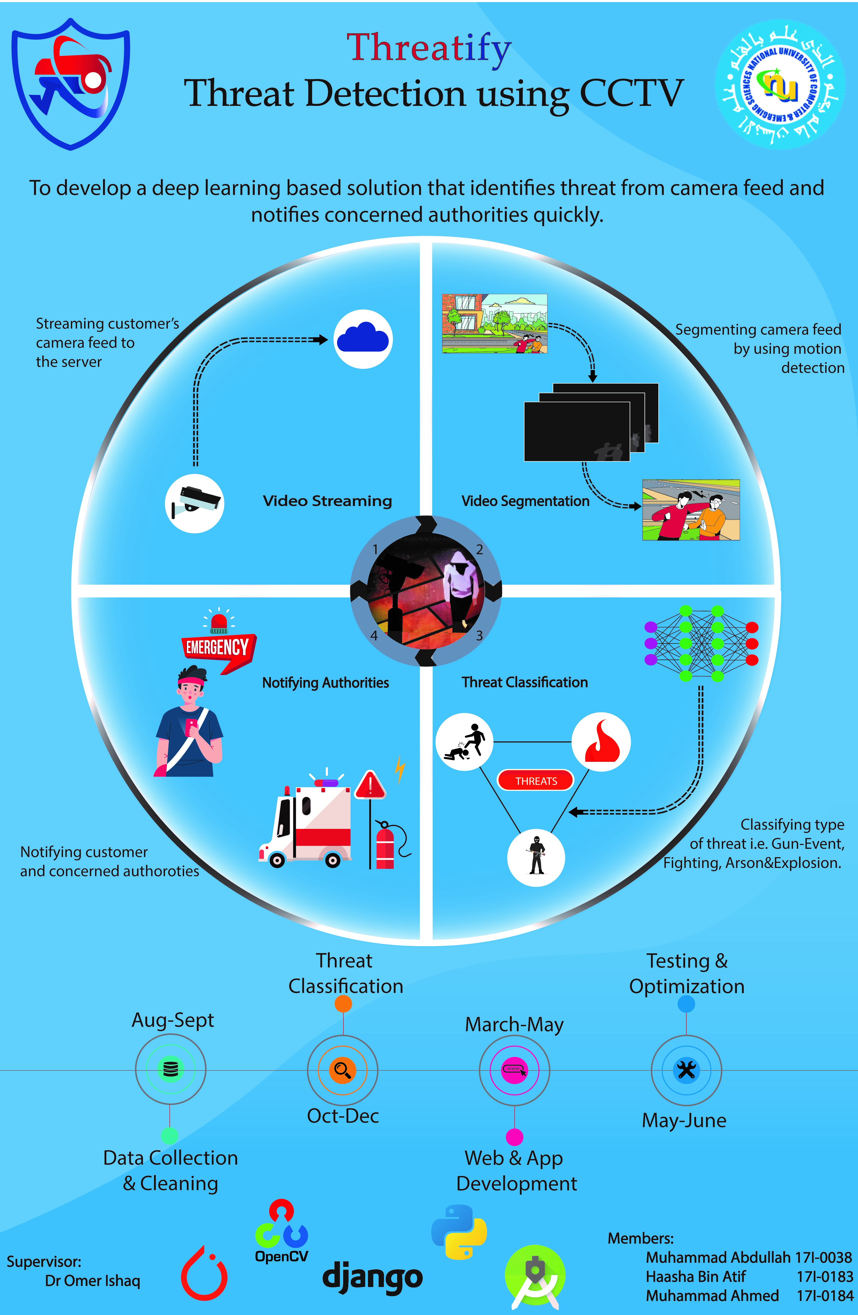
Poster

Slide 5
Timeline
Data Collection & Cleaning
Web & App Development
Testing & Optimization
Threat Classification
5

Slide 6
Progress
Website & App Development
Testing & Optimization
Data Collection & Cleaning
Threat Identification
Threat Classification Iter#1
Model Deployment
Threat Classification Iter#2
6

Slide 7
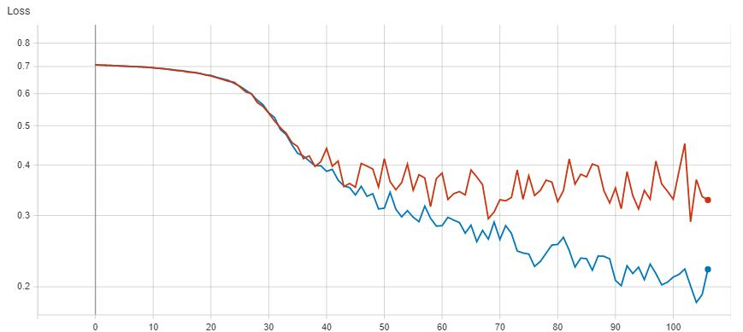
Results-Loss
Train
Test
Train
Test
Loss
Epochs

Slide 8
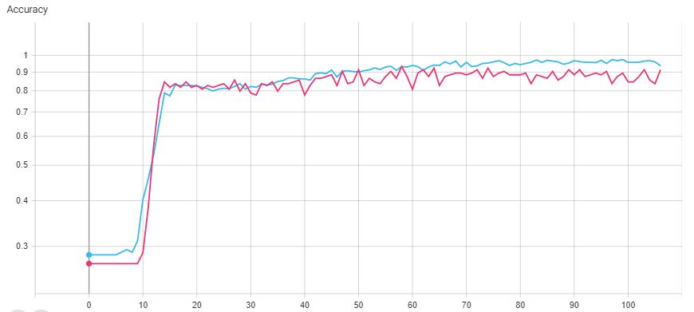
Results-Accuracy
Train
Test
Accuracy
Epochs

Slide 9
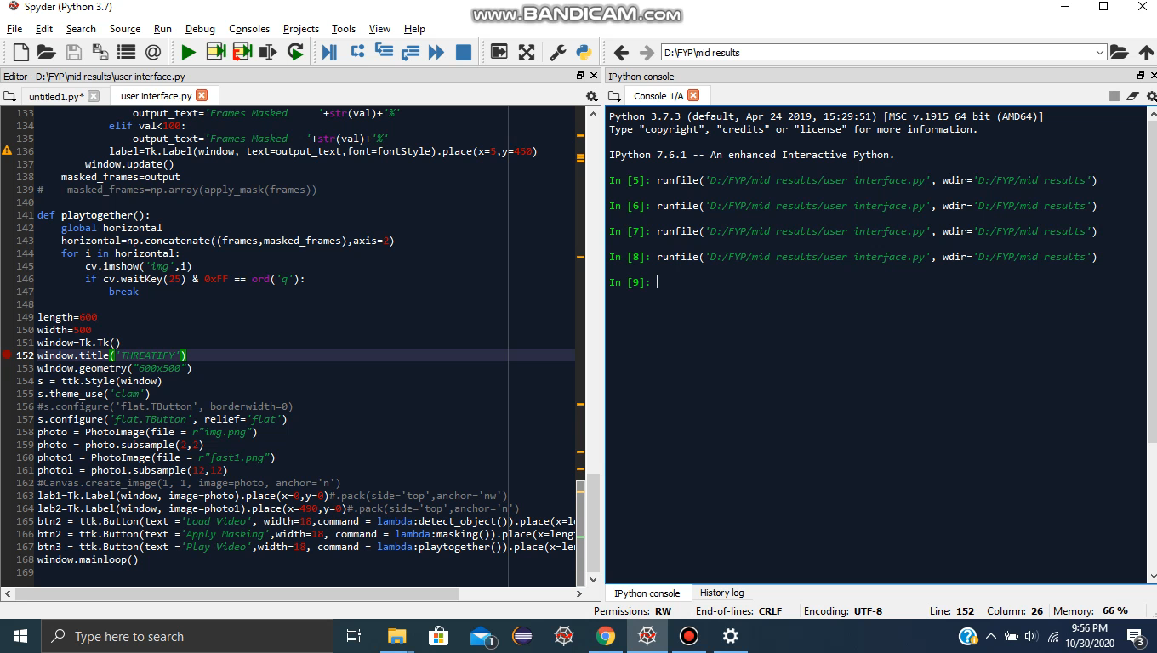
Results-Masking

Slide 10
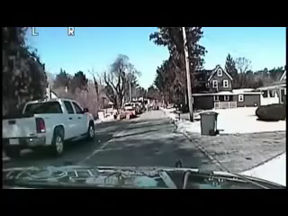
Results- Threat I

Slide 11
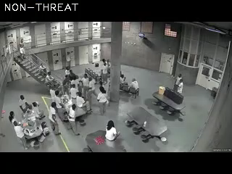
Results- Threat II

Slide 12
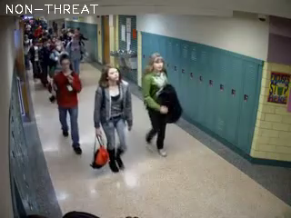
Results-Non Threat

Slide 13
User Interface (UI) Website

Slide 14
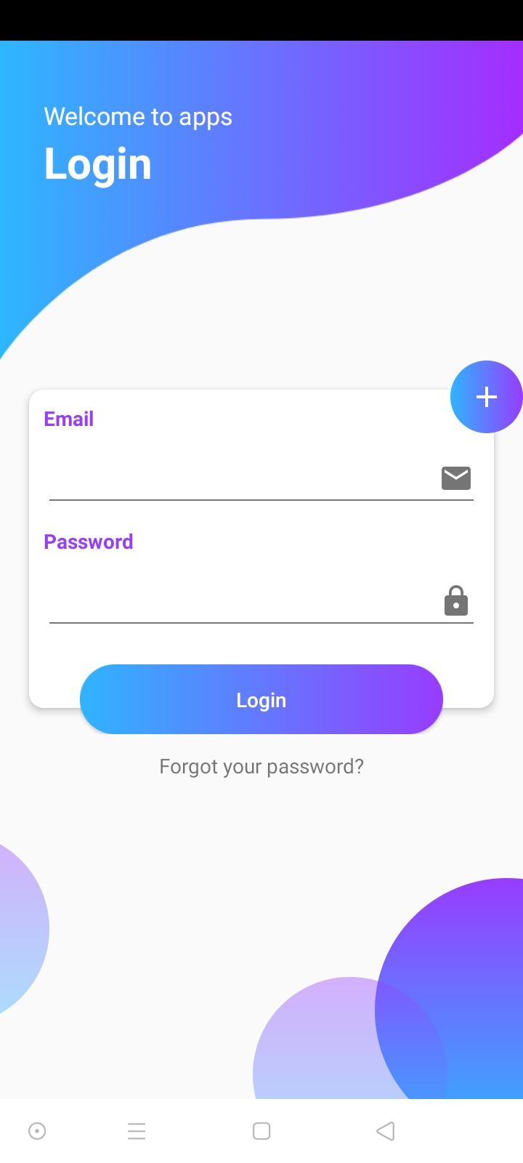
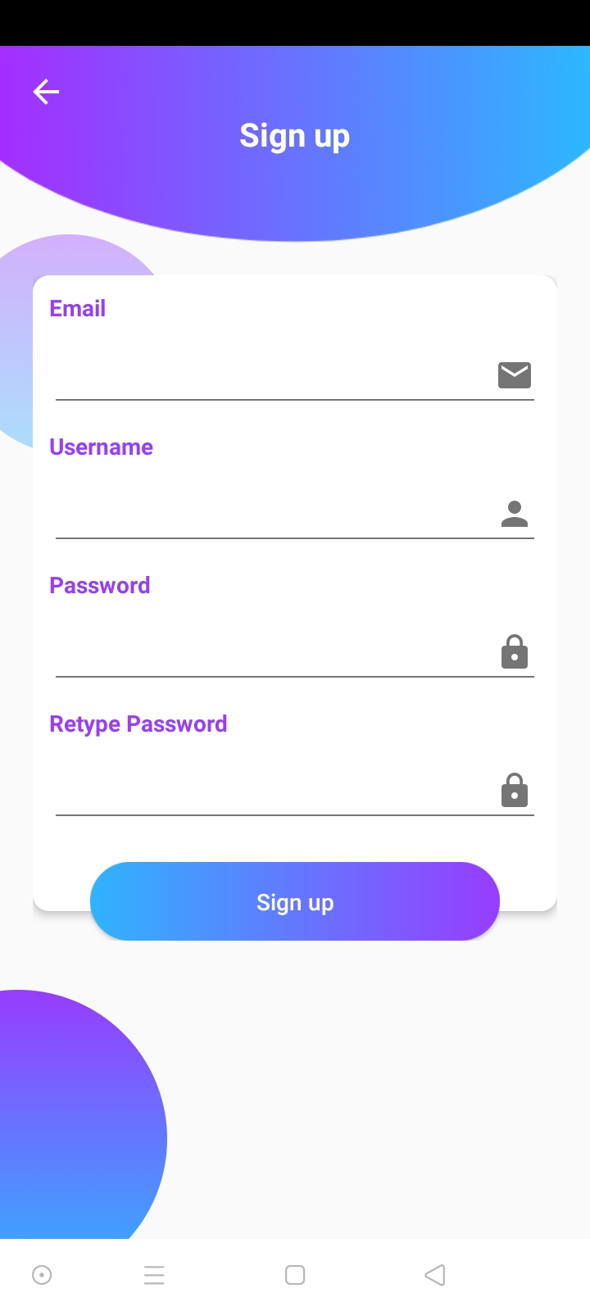
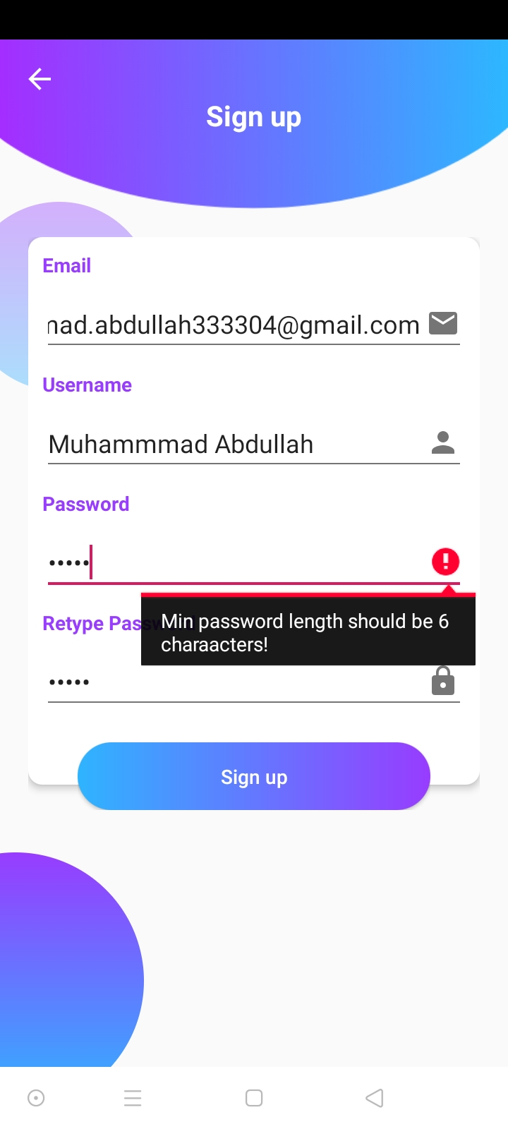
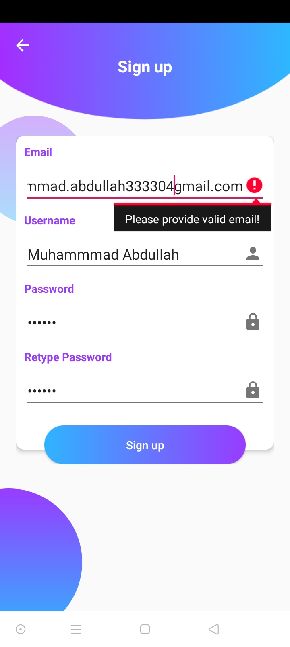
User Interface (UI) Mobile App

Slide 15
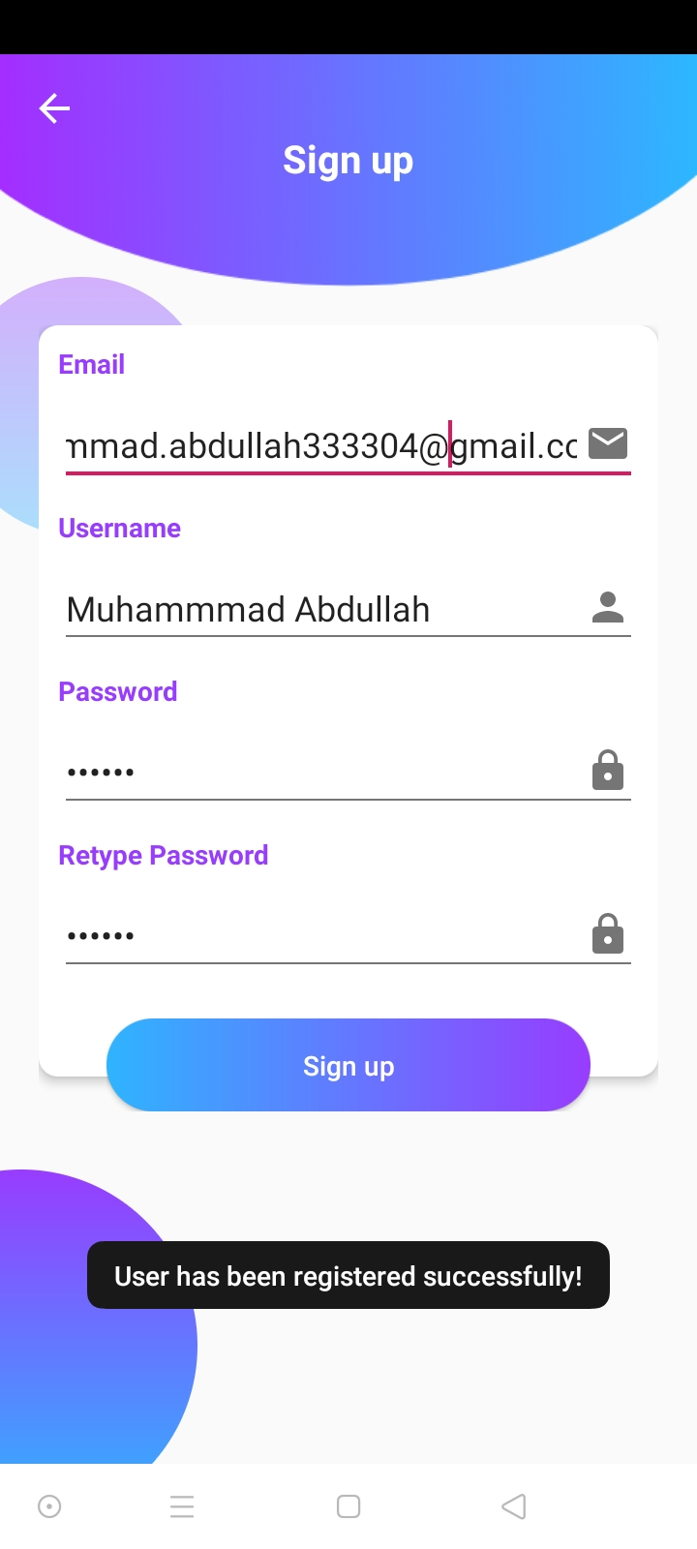
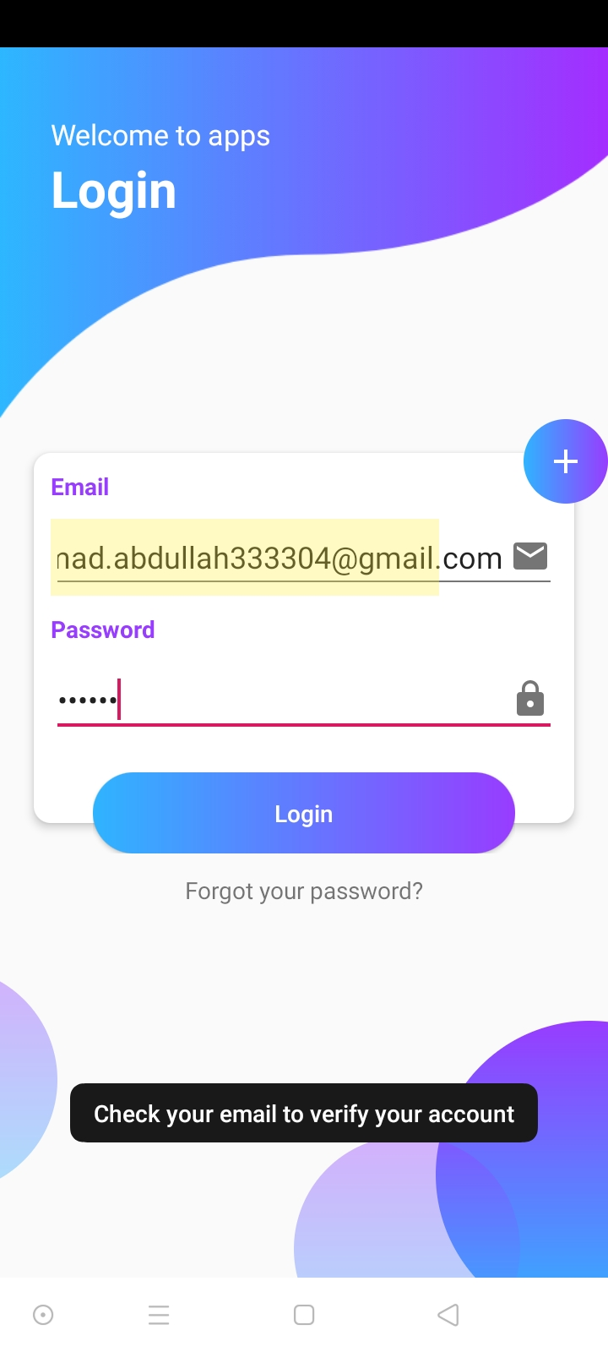
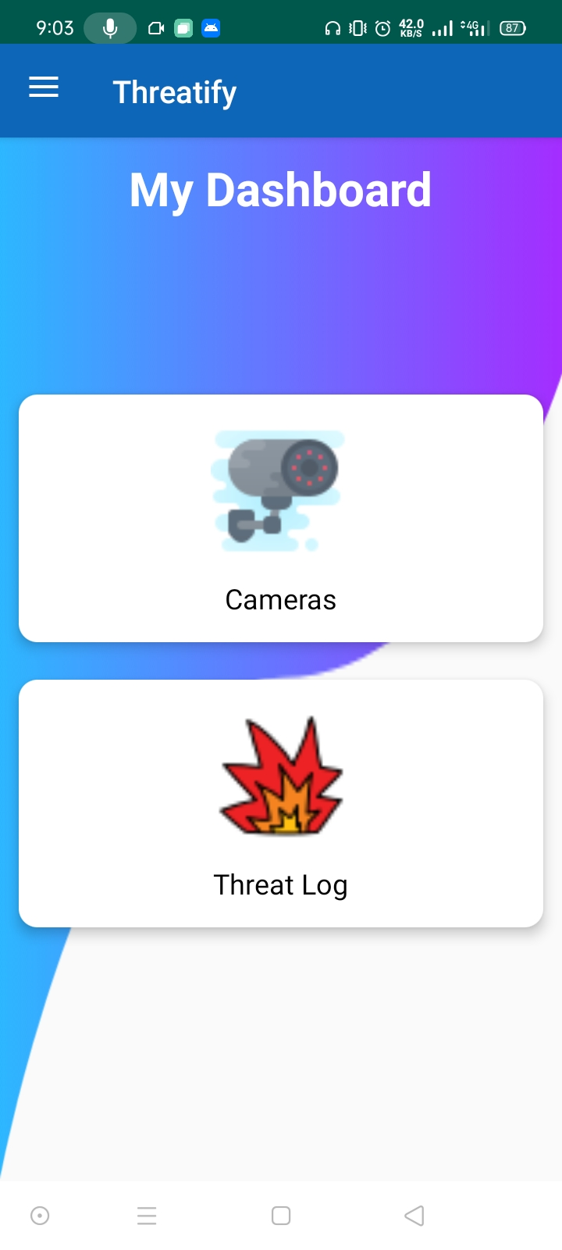
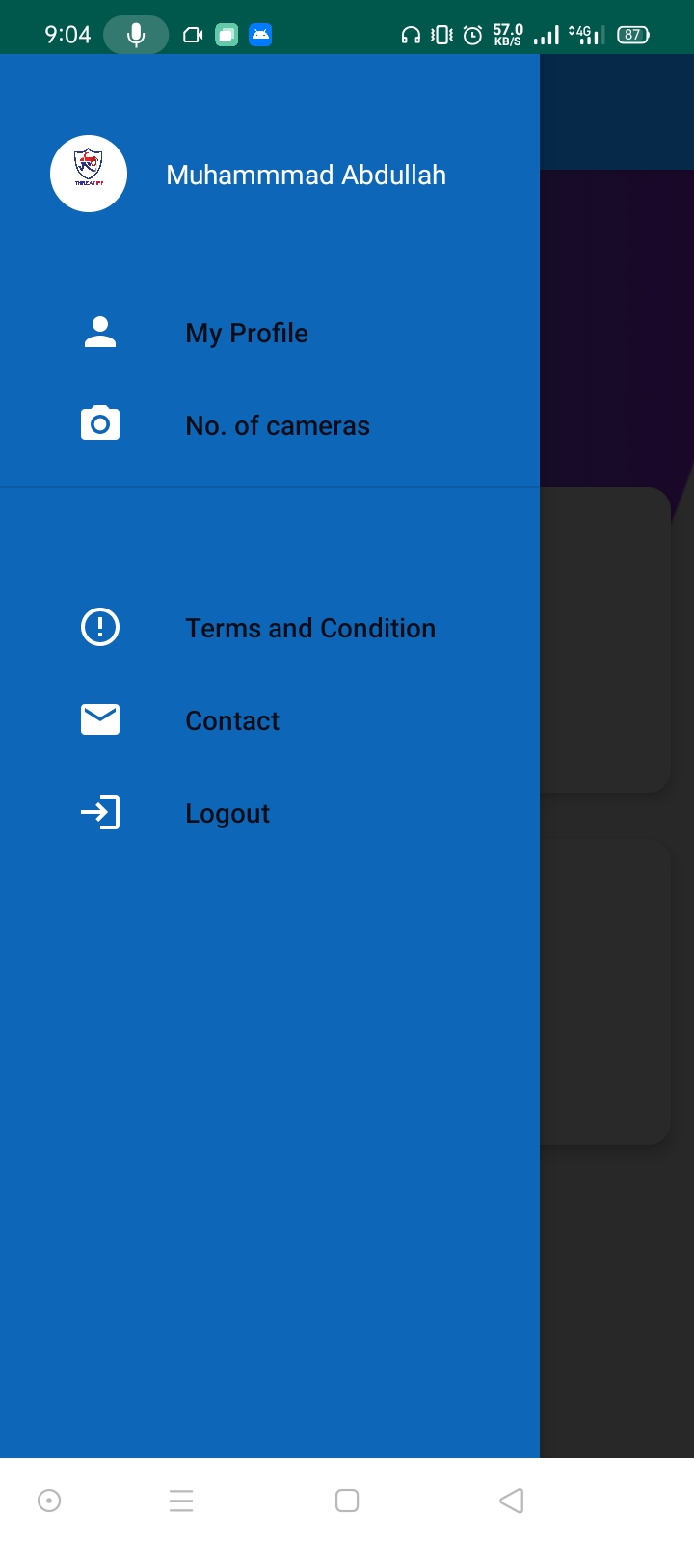
User Interface (UI) Mobile App

Slide 16
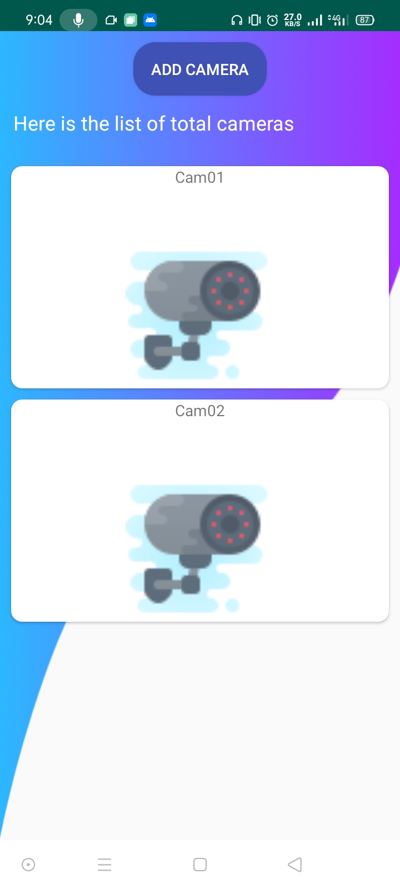
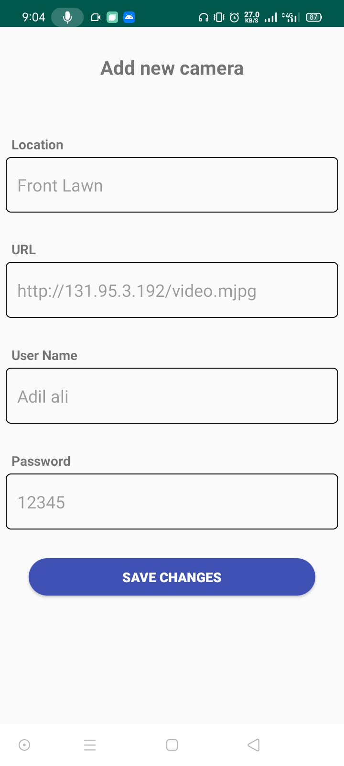
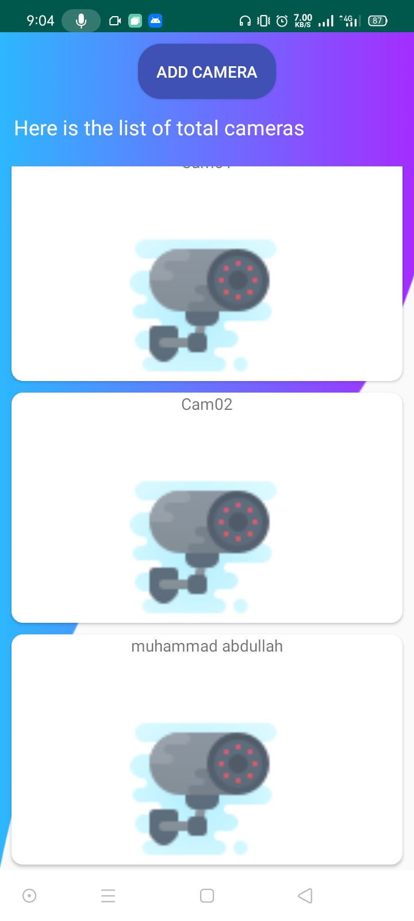
User Interface (UI) Mobile App

Slide 17
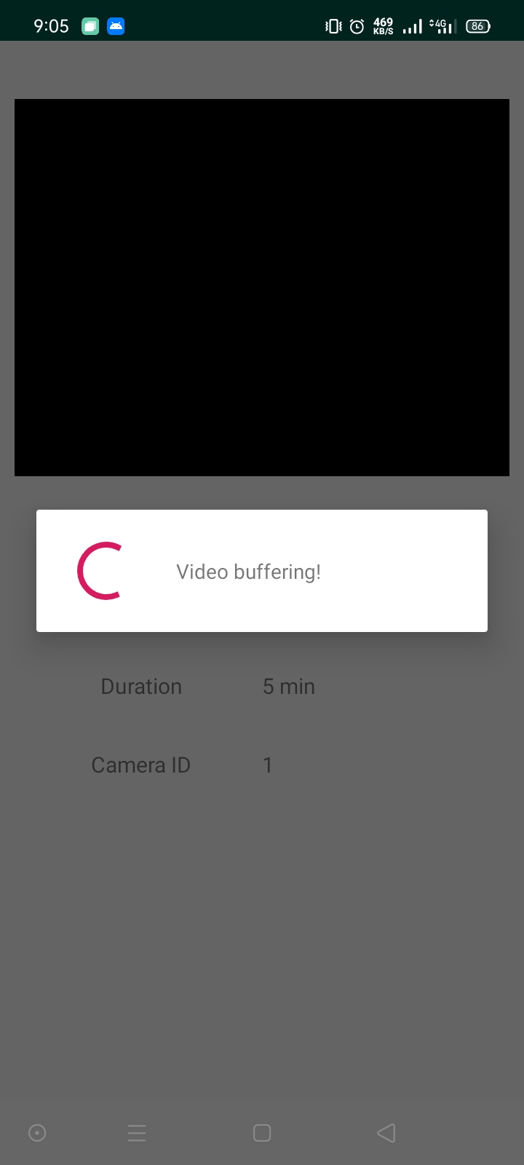
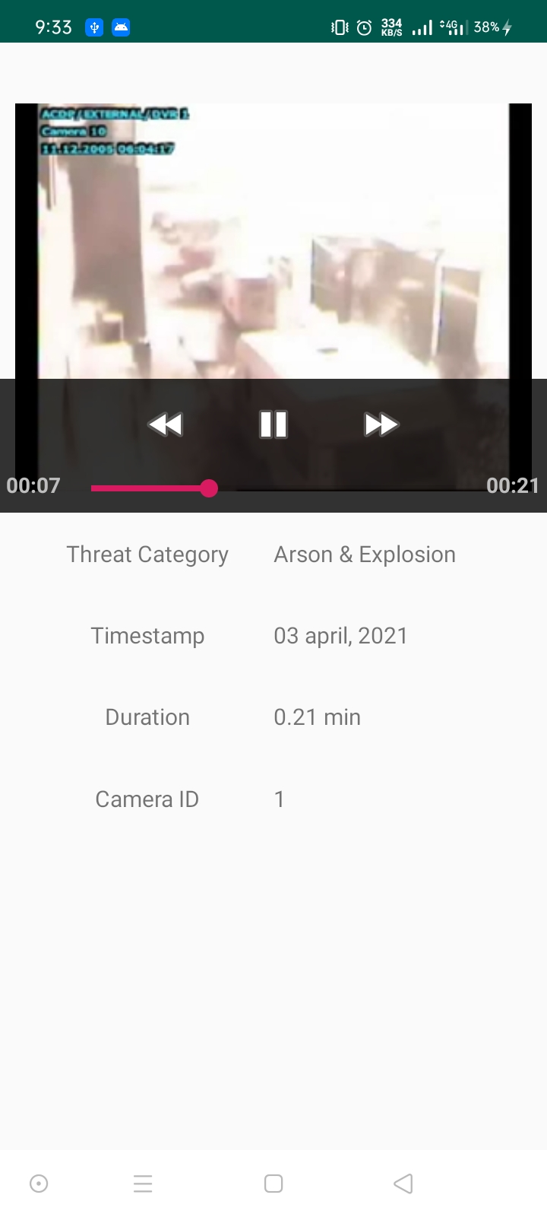
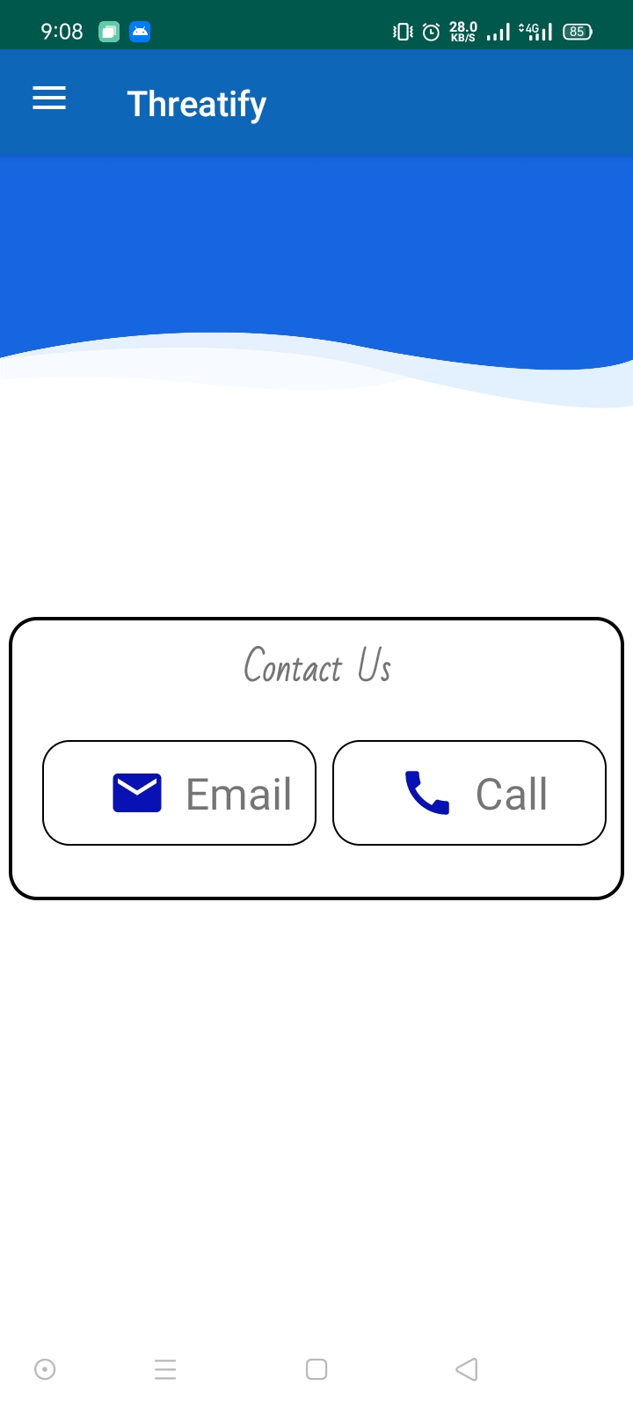
User Interface (UI) Mobile App

Slide 18
References
For Mobile App:
https://www.youtube.com/c/CodeWithMazn/about
https://www.youtube.com/c/SmallAcademy/about
https://github.com/sainalsultan
https://www.youtube.com/channel/UCG1aEPR4NO2Sd_mmJFimfQQ

Slide 19

Thanks!
Any Questions?

